Slide 1

MIT-WPU T.Y. B.Tech System Software and Compilers

Slide 2
Text Books & Reference Books
Text Books:
1.Dhamdhere D., "Systems Programming and Operating Systems", McGraw Hill, ISBN 0 -
07 -463579 – 4.
2. A V Aho, R Sethi, J D Ullman, \Compilers: Principles, Techniques, and Tools",
Pearson Edition, ISBN 81-7758-590-8.
3. John Donovan, “System Programming”, McGraw Hill, ISBN 978-0--07-460482-3.
Reference Books:
1. John. R. Levine, Tony Mason and Doug Brown, “Lex and Yacc”, O'Reilly, 1998, ISBN:
1- 56592-000-7.
2. Leland L. Beck, “System Software An Introduction to Systems Programming” 3rd
Edition, Person Education, ISBN 81-7808-036-2.
3. Adam Hoover, “System Programming with C and Unix”, Pearson,2010

Slide 3
Lab Implementation
Assignment No 3:
Design of Pass I of Two Pass Macro processor.

Slide 4
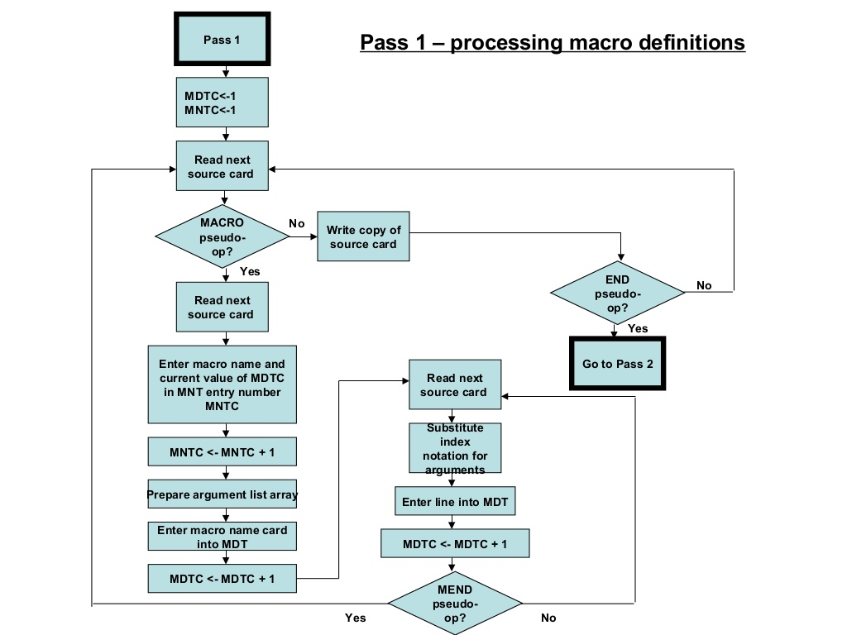

Slide 5
Sample Input Pass I
ALP with Macro Definition and Macro Call
MACRO
INCR &ARG1 &ARG2
ADD AREG &ARG1
ADD BREG &ARG2
MEND
START
MOVER AREG S1
MOVER BREG S1
INCR D1 D2
S1 DC 5
D1 DC 2
D2 DC 3
END
Macro Definition
Macro Call

Slide 6
Sample Output Pass I
MNT
MNT Index | Macro Name | MDT Index
1 | INCR | 1
ALP without Macro Definition but with Macro Call
START
MOVER AREG S1
MOVER BREG S1
INCR D1 D2
S1 DC 5
D1 DC 2
D2 DC 3
END
MDT
MDT Index | Instruction
1 | INCR &ARG1 &ARG2
2 | ADD AREG #1
3 | ADD BREG #2
4 | MEND
ALA
ALA Index | Dummy Arguments
#1 | &ARG1
#2 | &ARG2

Slide 7
Lab Implementation
Assignment No 4:
Design of Pass II of Two Pass Macro processor.

Slide 8
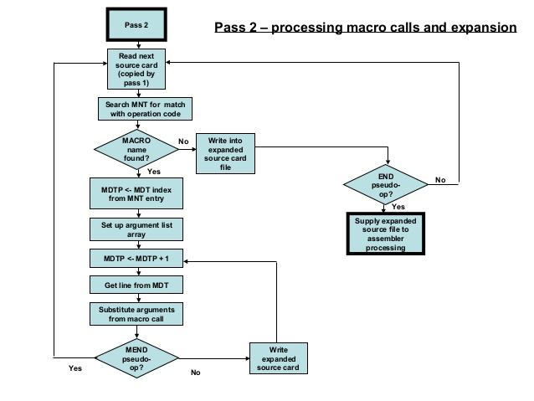

Slide 9
Sample Input Pass II
MNT
MNT Index | Macro Name | MDT Index
1 | INCR | 1
ALP without Macro Definition but with Macro Call
START
MOVER AREG S1
MOVER BREG S1
INCR D1 D2
S1 DC 5
D1 DC 2
D2 DC 3
END
MDT
MDT Index | Instruction
1 | INCR &ARG1 &ARG2
2 | ADD AREG &ARG1
3 | ADD BREG &ARG2
4 | MEND
ALA
ALA Index | Dummy Arguments
#1 | &ARG1
#2 | &ARG2

Slide 10
Sample Output Pass II
Modified ALA
ALA Index | Actual Arguments
#1 | D1
#2 | D2
ALP without Macro Definition and without Macro Call
START
MOVER AREG S1
MOVER BREG S1
ADD AREG D1
ADD BREG D2
S1 DC 5
D1 DC 2
D2 DC 3
END
Macro Expansion

